Slide 1
Adding Intelligence to your Node.js app using Azure
Steve Walker
Senior Marketing Manager : Azure Dev Communities
@azureclouddev
steve.walker@microsoft.com
Github: @SharePointing

Slide 2
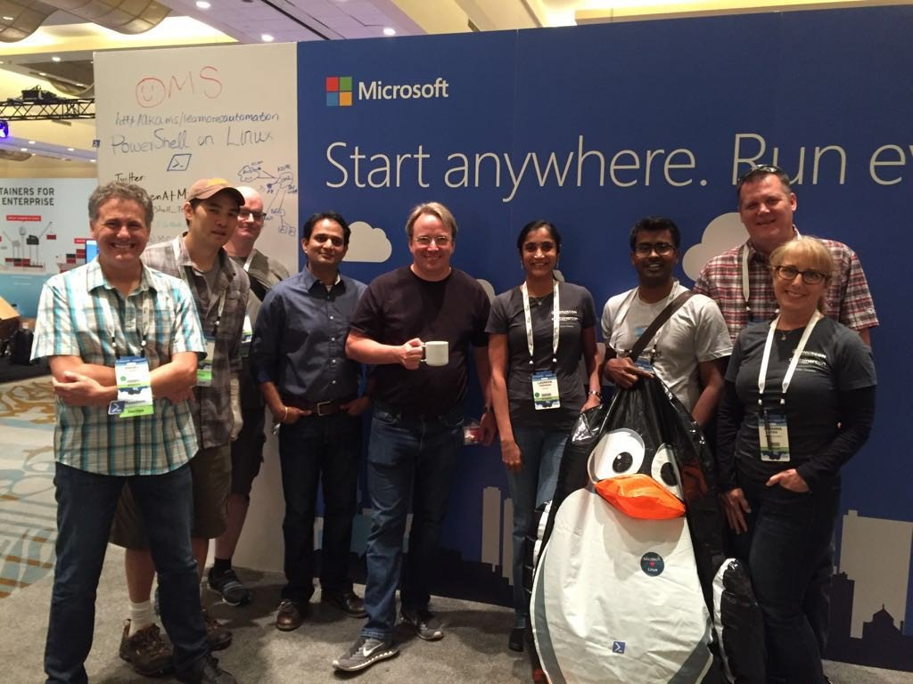
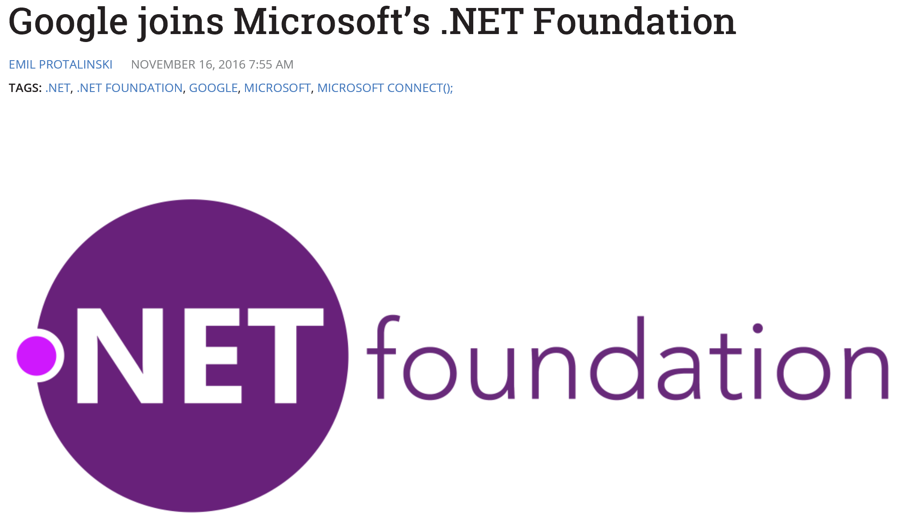
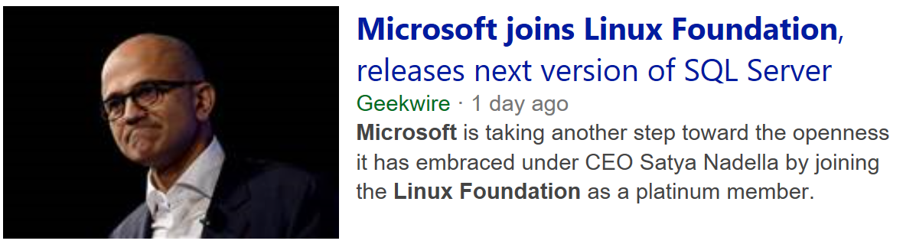
Dogs and Cats – Living together !!!!

Slide 3




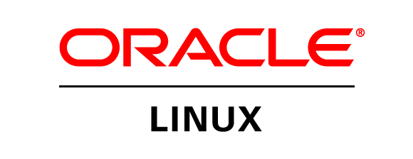
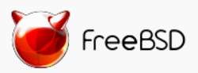

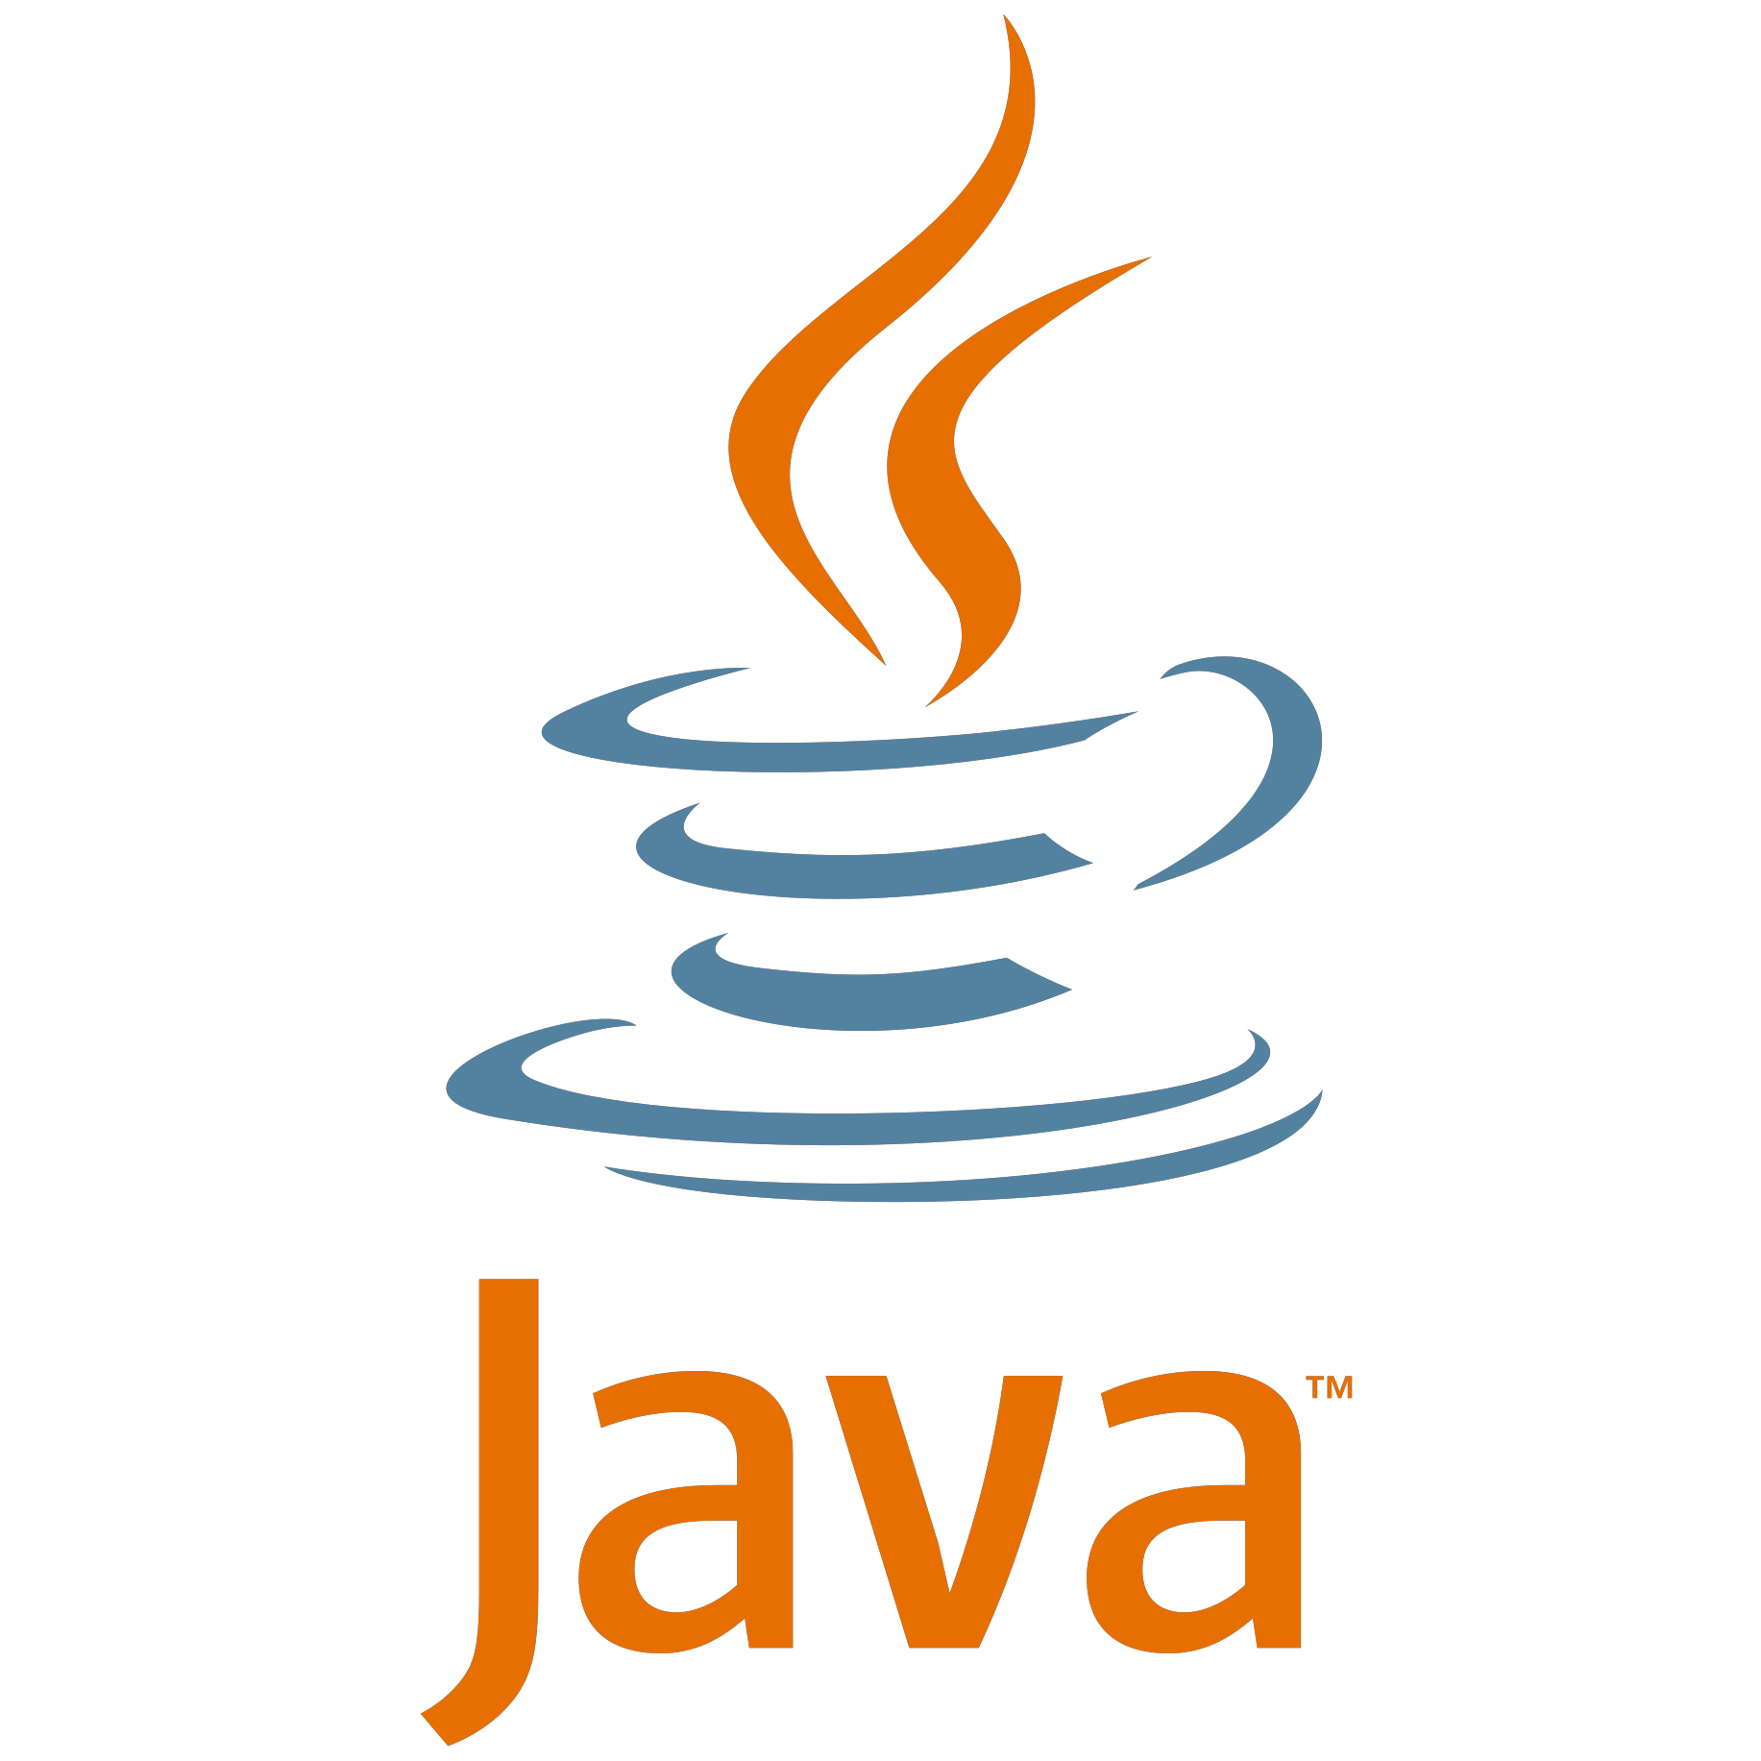


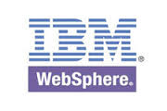









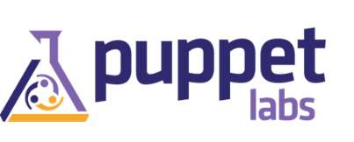

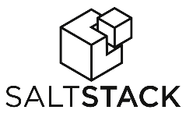


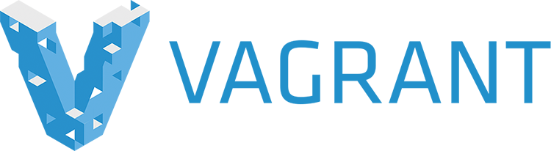

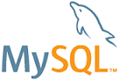
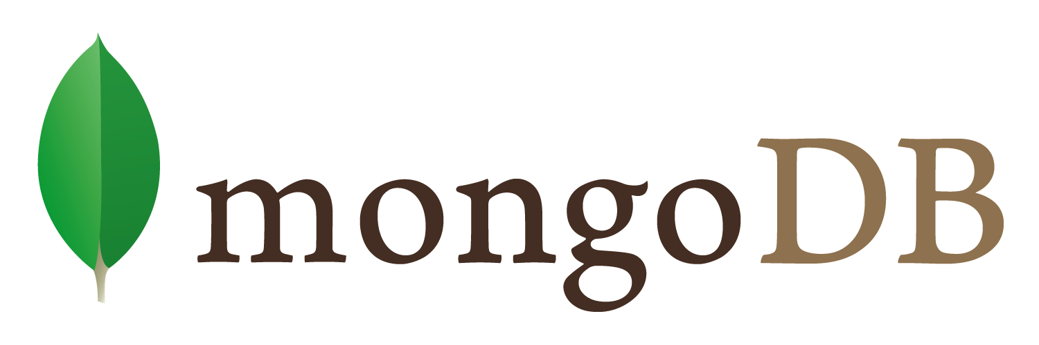



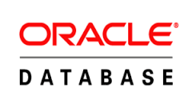
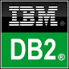


Azure Use your OS, frameworks, and data sources
Azure – use your OS, frameworks, and data sources
Infrastructure
Java apps
& tools
DevOps
Databases &
middleware
Notes:
This slide reinforces that Microsoft is committed to Java and Linux and it has been supporting it for a while
Highlight how it’s real business for Microsoft Today. 25%+ of VMs on Azure are Linux and that percentage is growing month on month basis. Azure manages thousands of Linux server on-premises…
Highlight that Microsoft has been supporting Linux since 2013, it’s no a bolt-on running on top of Windows
4. The Bash shell is coming to Windows. Yes, the real Bash is coming to Windows," said Microsoft's Kevin Gallo on stage at the Build 2016 keynote.
Part of the summer's Anniversary Update to Windows 10.
"This is not a VM. This is not cross-compiled tools. This is native," he said. "We've partnered with Canonical to offer this great experience, which you'll be able to download right from the Windows Store."
Third-party tools have enabled this sort of thing for years, but a direct partnership between Microsoft and Canonical should offer even more flexibility and convenience for developers who prefer using these binaries and tools.
This blog post by Microsoft's Scott Hanselman offers a deeper explanation of the move. “
This is an genuine Ubuntu image on top of Windows with all the Linux tools I use like awk, sed, grep, vi, etc. It's fast and it's lightweight. The binaries are downloaded by you - using apt-get - just as on Linux, because it is Linux. You can apt-get and download other tools like Ruby, Redis, emacs, and on and on. This is brilliant for developers that use a diverse set of tools like me.
This runs on 64-bit Windows and doesn't use virtual machines. Where does bash on Windows fit in to your life as a developer?
5. Oracle certification: Microsoft’s Azure platform remains the only certified cloud platform for running select Oracle products This link substantiates - http://www.oracle.com/us/corporate/press/1964592

Slide 4
Node.js + Azure

Slide 5
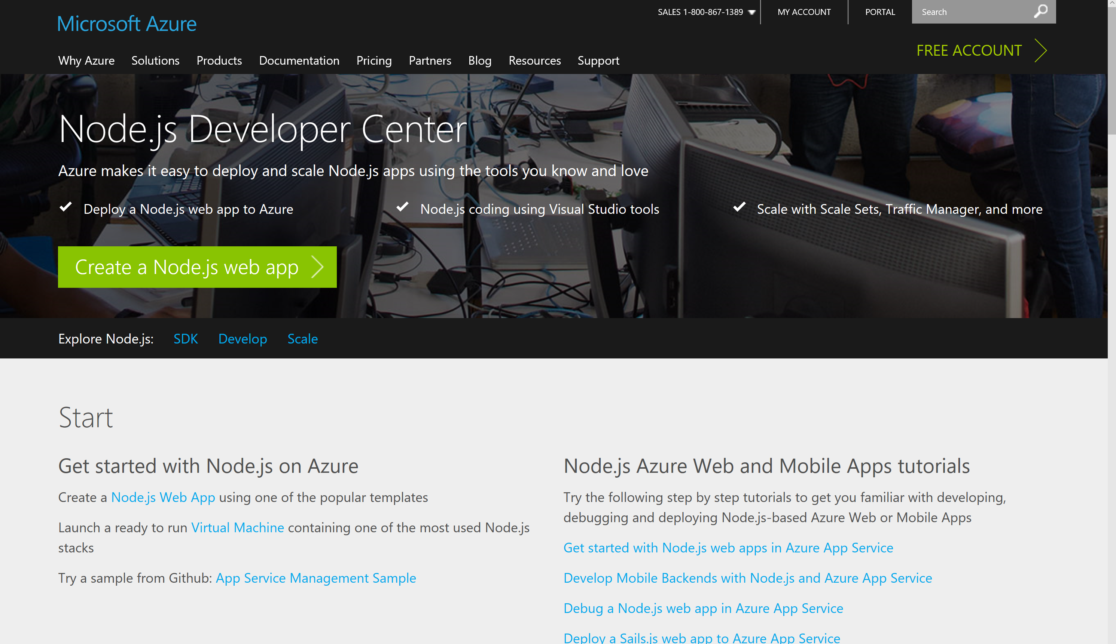
Node Dev Center – azure.com/node
Notes:
Show this page live – Show the various resources available
Let them know this is a work in progress and we WANT feedback

Slide 6
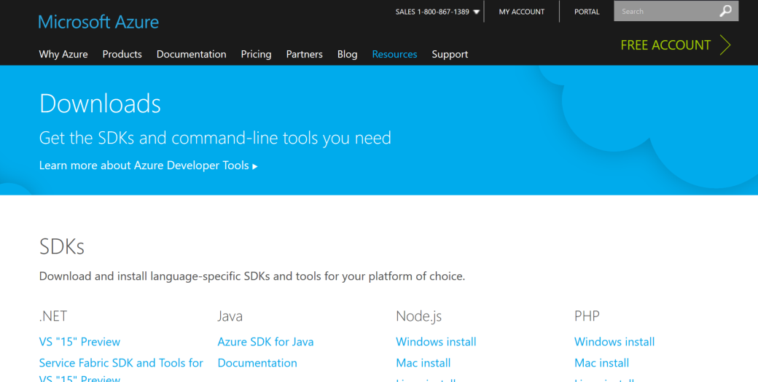
azure.microsoft.com/downloads/
Notes:
Show this page live – highlight the Node.js SDK and docs
Talk about how we manage the SDKs in GitHub and that Issues or feature requests can be made there.

Slide 7
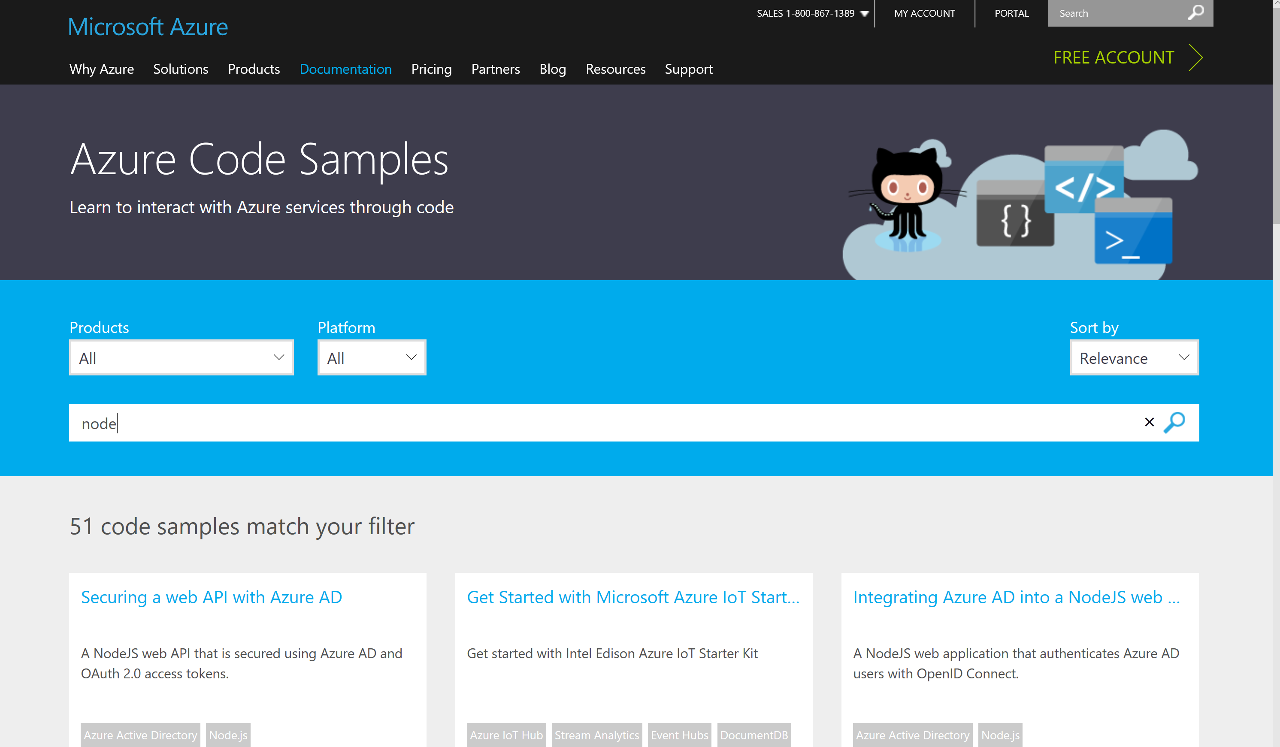
Node.js Code Samples
Notes:
https://azure.microsoft.com/en-us/documentation/samples/?term=node

Slide 8







SDKs for Node
Storage
Active Directory
Full developer ecosystems in Azure for your deployment needs and beyond
Key Vault
ApplicationInsights
Resource Manager
DocumentDB
SQL Database
SQL Azure
Web Apps
Data Lake
Cognitive Services Coming Soon !!!
Media Services
Management
Scheduler
Service Bus
Notification Hubs
Notes:
Node – https://github.com/Azure/azure-sdk-for-node

Slide 9
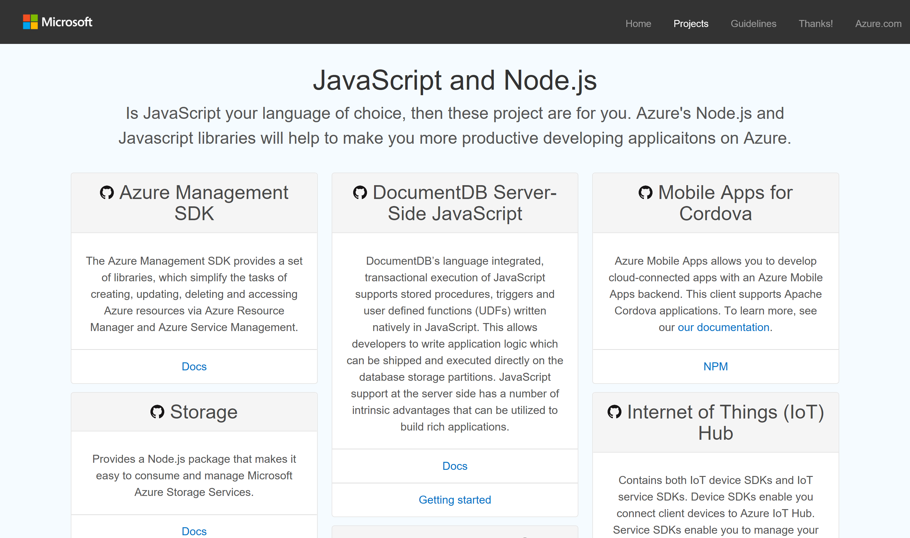
azure.github.com
Notes:
Show this page live – highlight the JavaScript and Node.js section of the frameworks and SDK projects
Most, if not all, projects are released under Apache 2.0

Slide 10
Deployment Options

Slide 11
Deployment Options in Azure
IaaS
PaaS
Virtual Machines
VM Extensions
+ Containers
VM ScaleSets
App Service, Cloud Foundry,
Container Services
Service Fabric
Bring your Code
Automate everything
Elastic Declarative
Stateless & Stateful
Ultimate
Control
Cost &
Agility
Notes:
This slide highlights the spectrum of options from IaaS to PaaS that Azure brings for Java.
Highlight the existing options to create Linux VMs and automate them using extensions and containers.
Highlight ScaleSets and Service Fabric.

Slide 12
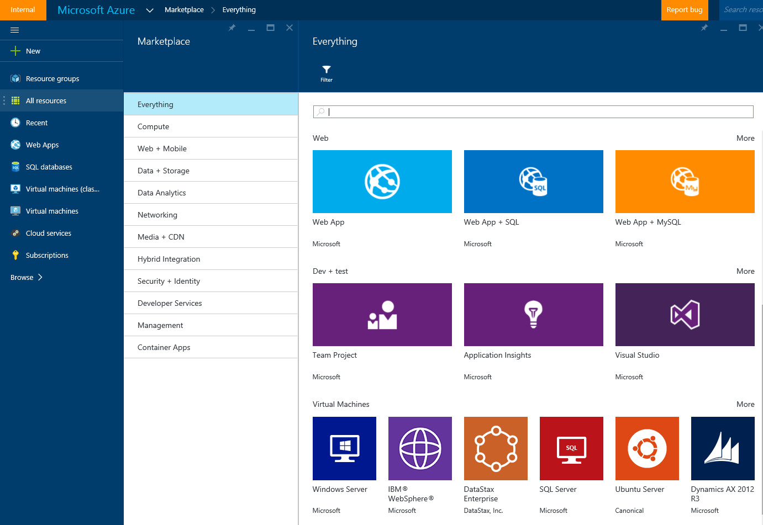
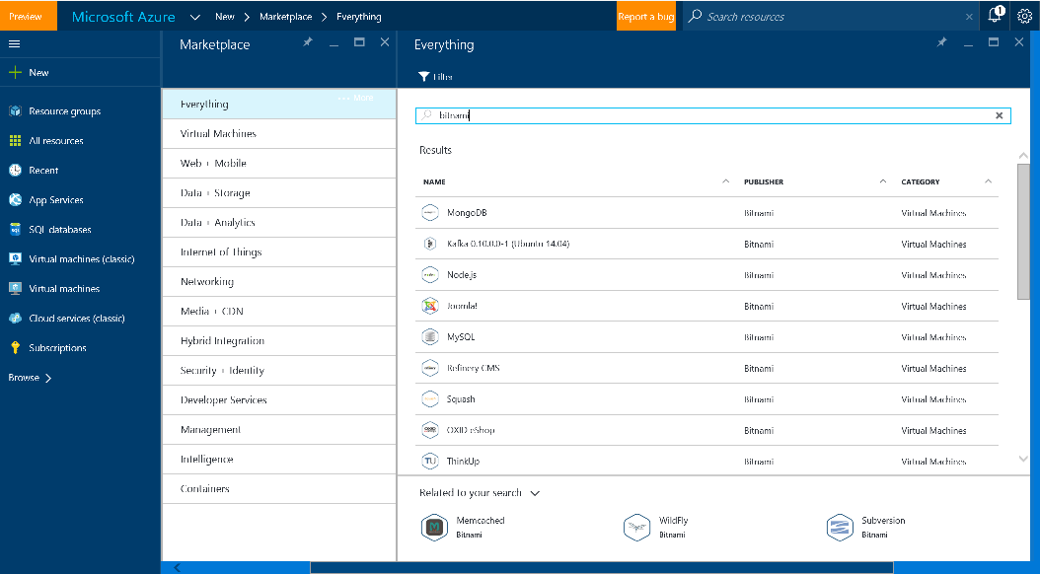
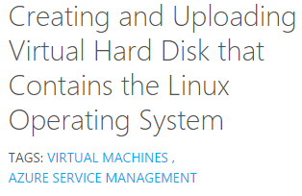
VMs – Many ways to get started
Marketplace
Community
BYOI
Notes:
This slide ways to multiple ways available to get VMs going
Highlight the Marketplace – VM’s Published, maintained and supported by partners, curated & tested by Microsoft
Standard Linux Images : Customers to contact vendor/partner for Linux support. Azure-related platform issues supported by Microsoft.
Premium Images : Microsoft engages the Linux vendor/partner on behalf of the customer for support; SUSE SLES 11SP3 only
Highlight Community Images - community managed of Linux and FreeBSD virtual machine images for easy deployment to Microsoft Azure.
Highlight BYOI - It’s possible to create & upload a Virtual Hard Disk (VHD), so you can use it as your own image to create multiple VMs based on that Image.
Conceptual Steps
Prepare a VHD that runs on Hyper-V hypervisor
Install LIS if Needed, Install Linux Agent
Upload VHD to Azure Storage.
Create VM image from Uploaded VHD (Azure CLI, Portal)

Slide 13
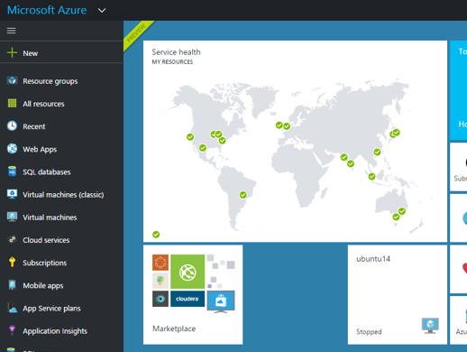
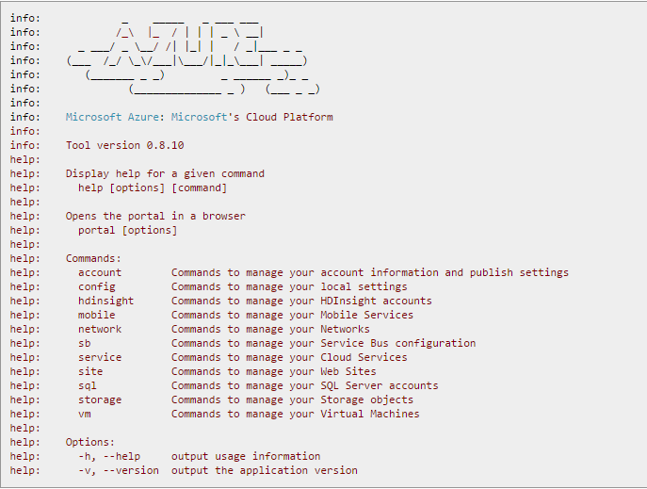
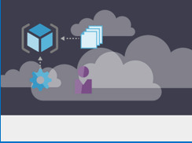
Provisioning
Azure Portal
Azure CLI
ARM Templates
MICROSOFT CONFIDENTIAL
Notes:
Speaker Pointers:
1. This slide highlights the multiple ways to provision VMs

Slide 14
Demo – Deployment Options
Notes:
Break Out and show the deployment using the following means:
Azure Portal – deploy from Marketplace
Azure CLI – show how to script deployment using the CLI
ARM – show the power of ARM templates

Slide 15
Azure Resource Manager
Azure Templates can:
Ensure Idempotency
Simplify Orchestration
Simplify Roll-back
Provide Cross-Resource Configuration and Update Support
Azure Templates are:
Source file, can be checked-in
Specifies resources and dependencies (VMs, WebApps, DBs) and connections (config, LB sets)
Support parametized input/output.
Open to community for contribution
My App
Instantiation of repeatable config.
Configuration → Resource Group
[SQL CONFIG] VM (2x)
DEPENDS ON SQL
DEPENDS ON SQL
SQL
WebApp
Virtual
Machines
Install Java stack post provisioning
SQL
C
ONFIG
Notes:
To do real, repeatable work templates can be a huge time saver
Idempotent – reusable components
Define resources as source – check it in, version it.

Slide 16
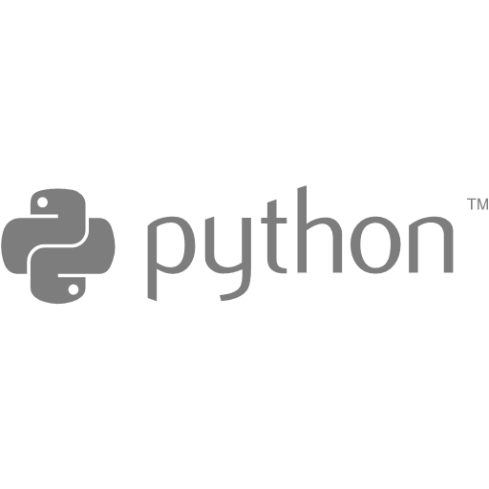
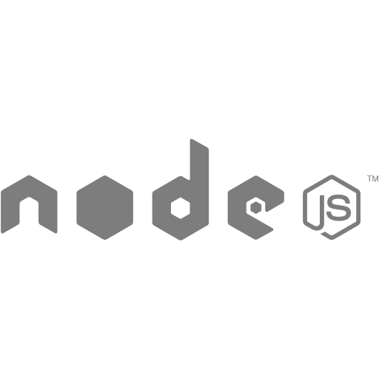
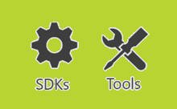
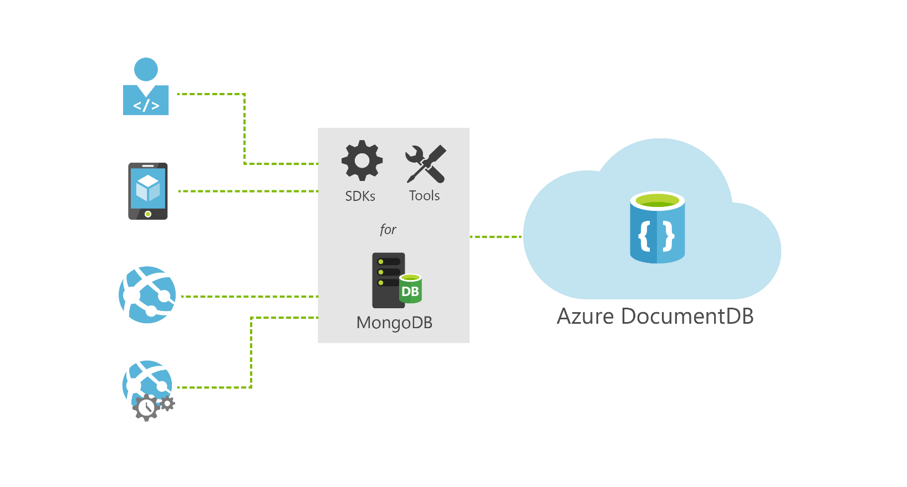

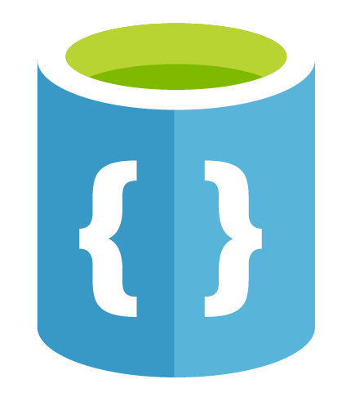

DocumentDB: Tools, SDKs and protocol support for MongoDB
Ruby
MongoDB wire protocol
…
Java
.NET
drivers for MongoDB
REST over HTTPS/TCP
Java
.NET
DocumentDB
Notes:
Have numbers to back up these points

Slide 17
Now, Let’s get some Intelligence into our app!
Cognitive Services APIs provide services that your app can use no matter where it is hosted!
Vision – Detect faces, emotions and respond within your app
Speech – Recognize speech, translate to text.
Language – Spell Check, Linguistic analysis, Text Analytics.
Knowledge – Academic, Entity Linking, Knowledge Exploration, Recommendations
Search – Numerous Bing Search Services for Images, News, Videos, and general Web Search.
Notes:
Talk through the various services. Give examples of how thse could be leveraged in an application.

Slide 18
The Setup
You need an Azure Subscription (Various options to get them, Trial, AzurePass, Dev Essentials, MSDN, Company Subscription)
NOTE: Will need this regardless of whether you host your app in Azure. This is to enable you to utilize the services within your app.
You will need to set up Application Keys for our Cognitive Services
[TODO: Insert Instructions Here OR Make a demo slide and show it]

Slide 19
Demo – Cognitive Services
Notes:
## Create a local directory to use
mkdir Contacts
## Clone git repo
git clone https://github.com/Azure-Samples/app-service-api-node-contact-list.git
## Autogenerate node.js code from Swagger metadata
## this installs it globally - Not needed each time
npm install -g yo
npm install -g generator-swaggerize
## change directories to the cloned repo
cd app-service-api-node-contact-list
cd start
## now actually generate the api code
yo swaggerize
contactlist
api.json
express
## go to the generated application
cd contactlist
npm install
npm install --save jsonpath
##install swaggerize UI module
npm install --save swaggerize-ui
##copy in the library code
copy lib folder from root to generated contactlist folder
## now open VSCode
code .
##replace handlers/contacts.js with the following code:
'use strict';
var repository = require('../lib/contactRepository');
module.exports = {
get: function contacts_get(req, res) {
res.json(repository.all())
}
};
## replace the code in handlers/contacts/{id}.js with
'use strict';
var repository = require('../../lib/contactRepository');
module.exports = {
get: function contacts_get(req, res) {
res.json(repository.get(req.params['id']));
}
};
## Replace servier.js code with the following:
'use strict';
var port = process.env.PORT || 8000; // first change
var http = require('http');
var express = require('express');
var bodyParser = require('body-parser');
var swaggerize = require('swaggerize-express');
var swaggerUi = require('swaggerize-ui'); // second change
var path = require('path');
var app = express();
var server = http.createServer(app);
app.use(bodyParser.json());
app.use(swaggerize({
api: path.resolve('./config/api.json'), // third change
handlers: path.resolve('./handlers'),
docspath: '/swagger' // fourth change
}));
// change four
app.use('/docs', swaggerUi({
docs: '/swagger'
}));
server.listen(port, function () { // fifth and final change
});
## now we will run it locally
node server.js
## navigate to URL
http://localhost:8000/contacts
## Navigate to a single contact item
http://localhost:8000/contacts/2
## show the swagger endpoint
http://localhost:8000/swagger
## show the docs endpoint for the UI goodness
http://localhost:8000/docs
## set up app service
## browse to Azure Portal
New > Web + Mobile > API App
## used IgniteYourNode as both name and resource group
## set up API app for Git Deployment
Navigate to App Services > API App
Settings > Publishing > Credentials
<Name: IgniteYourNode
pwd: 4XoiAUoi/>
## now set the deployment source
Deployment Source > Choose Source > Local Git Repo
## Get the repository URL
Essentials > Git Clone URL
https://IgniteYourNode@igniteyournode.scm.azurewebsites.net:443/IgniteYourNode.git
## copy the contactlist folder to a location that can be used as a local git repo
# in the demo example - I copied from the generatoed folder to code\ignite\contactlist
## initialize git in this local folder
git init
## now push the folder to the remote repo
git remote add azure https://IgniteYourNode@igniteyournode.scm.azurewebsites.net:443/IgniteYourNode.git
##Create initial commit
git add .
git commit -m "initial revision"
## now push the repo to azure
git push azure master
## you can see the deployment status in App Service > App Deployment > Deployment options
## You can also see that the command window shows a status as it progresses
## once it's complete, we can now test out the API in Azure
http://igniteyournode.azurewebsites.net/contacts
## also show the Swagger UI page as we did before.
http://igniteyournode.azurewebsites.net/docs

Slide 20
We want to hear from YOU!
SDK Feedback – https://github.com/Azure/azure-sdk-for-node
General Feedback
Feedback.azure.com (Use the General Category and Indicate Node: Feedback)
Community Support (We are there ☺ )
Stack Overflow – Tag with Node & Azure
Twitter
@OpenAtMicrosoft
@AzureCloudDev

